Slide 1
wikihistorybook
Final presentation Coin Seminar
Notes:
nici

Slide 2
Today we‘re gonna be talking about
Problem
About Wikipedia
Preconditions & technology
Organisation
Methods used
Main results
Demo
Conclusion / retrospective
Q&A
Notes:
nici

Slide 3
Problem - requirements
Finding the world’s leaders through the ages through Wikipedia social networks
Wikipedia-Data over last 4‘000 Jahre
Time Slider with most important historical actors
10 year-steps visualized as network
Prioritising inside the network
Notes:
nici

Slide 4

Wikipedia
Free online lexicon
collaboratively edited, multilingual, free-access, free content Internet encyclopedia
30 million articles
Articles connected with Backlinks
= Network
Notes:
simon

Slide 5
Preconditions & technology
Database-dump
Person data
Clear specifiation
Implementation planned with Open GL
discarded
Graphstream (Java Graph Library)
Notes:
simon

Slide 6
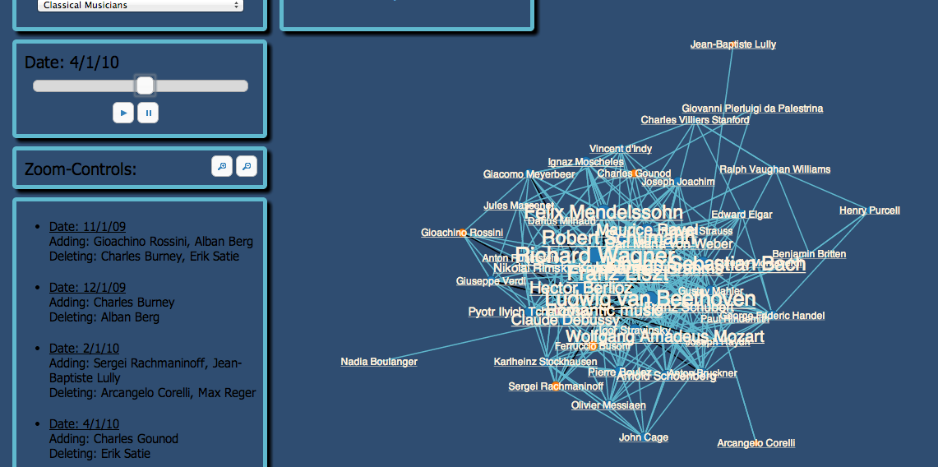
Notes:
simon

Slide 7
Organisation
5 Students from Brugg, 1 Student from GER
Code versioning on github
Work packages & milestones
Requirements, packages, protocols on Google Drive
Notes:
simon

Slide 8
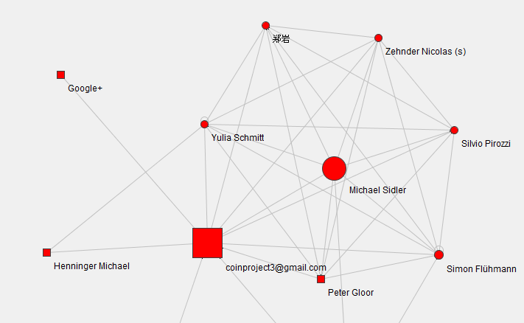
Notes:
simon

Slide 9
Methods used
Prototyping
Technical puncture
Visible progress
Perfect division of work
Weekly meetings
Weekly sprint reports
Notes:
michi

Slide 10
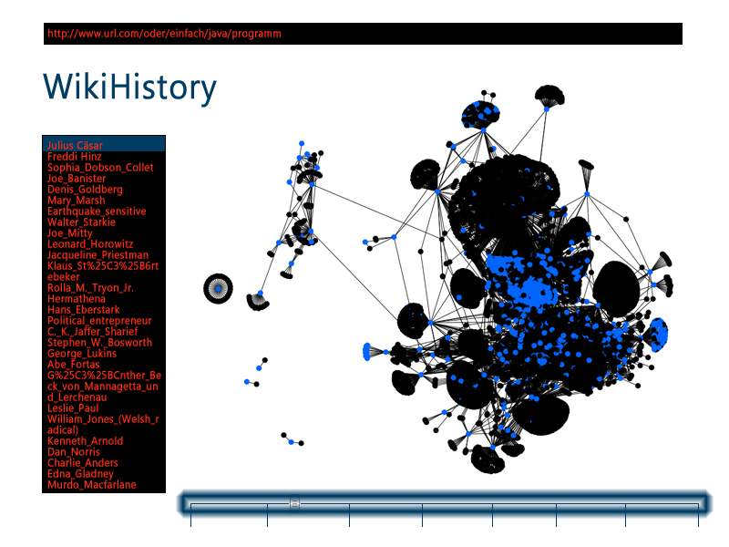
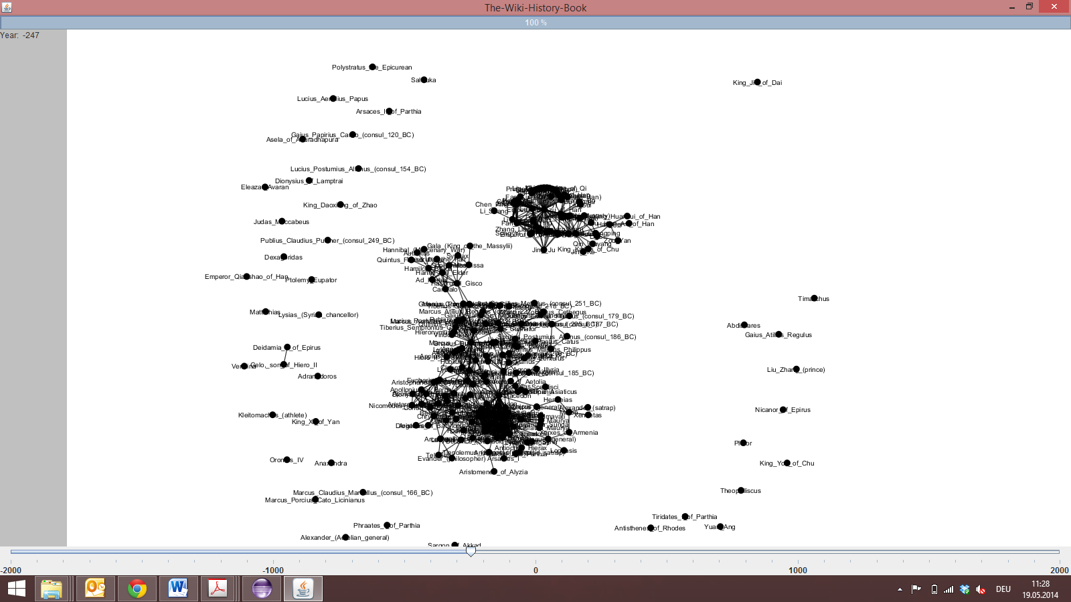
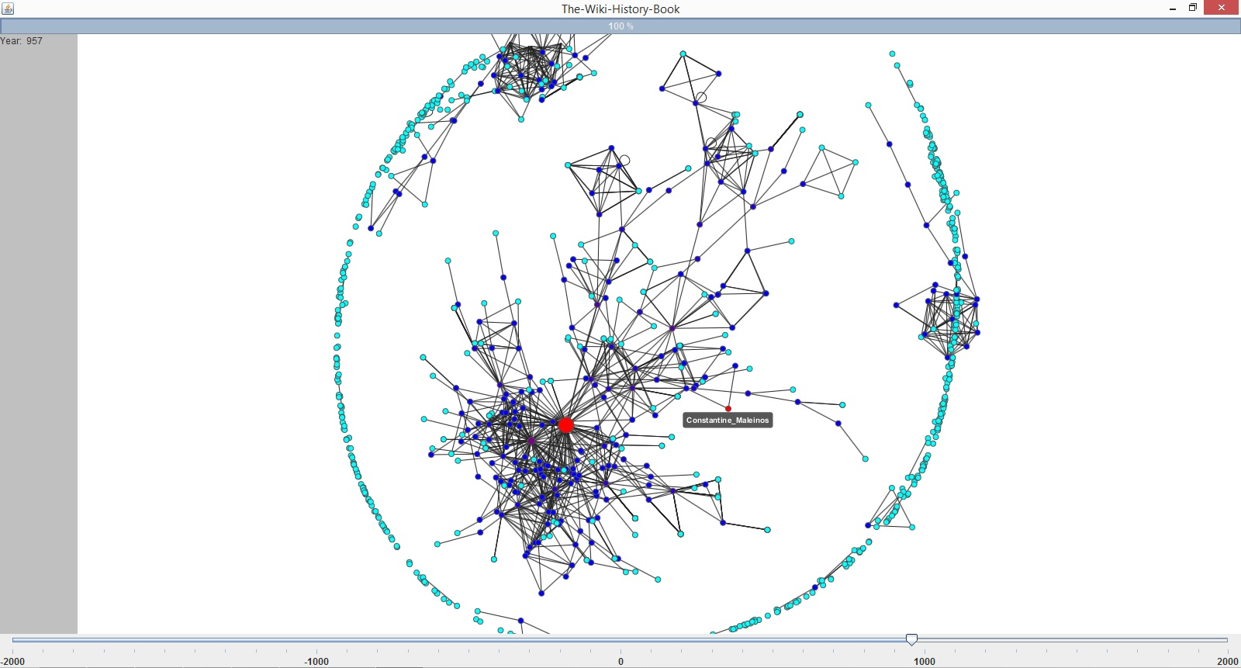
Notes:
michi

Slide 11
Main results
Requirements fulfilled
„Movie“ was not implementable
Huge amount of data (Performance)
Not flexible for future articles
Notes:
michi

Slide 12
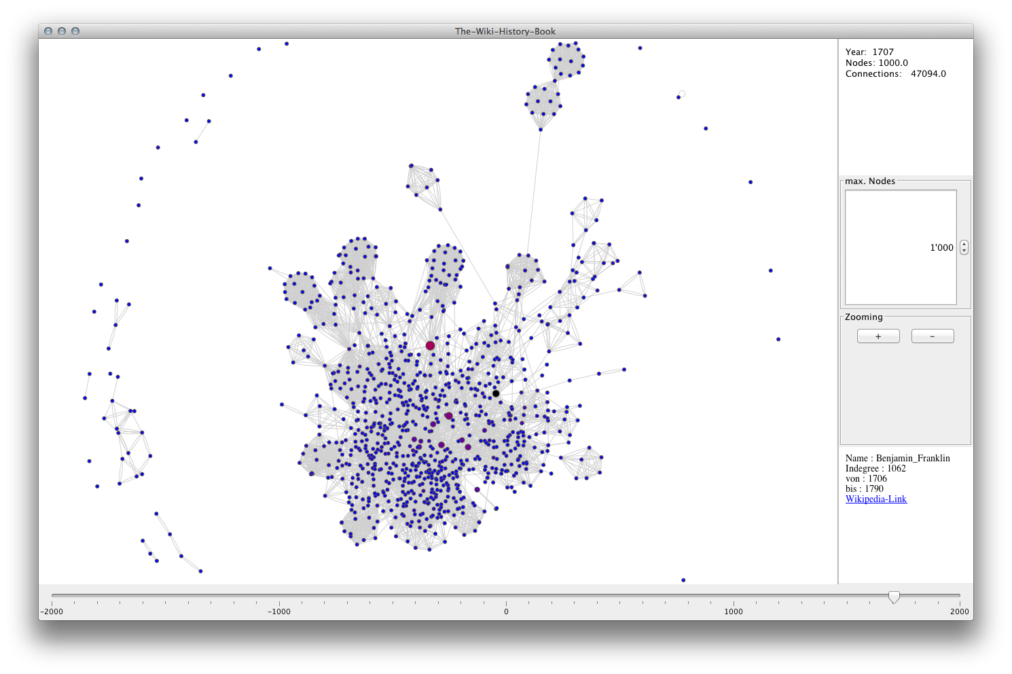
Notes:
silvio

Slide 13
Retrospective
Git sometimes annoying
All Status-Reports every week: time consuming
5:1 – better mixture of students
Got out maximum in limited time frame
Notes:
simon

Slide 14
Questions & Answers
We love to answer your questions now
Notes:
all

Slide 15
Danke & Tschüss

